Slide 1
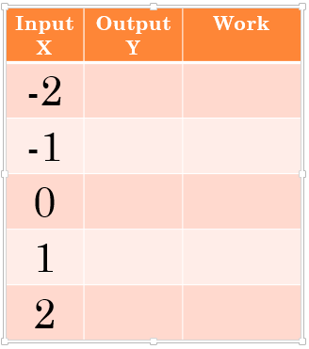
Warmup
y = 3x+5

Slide 2
Graphing Linear Equations
Chapter 5
Section 1 and 2

Slide 3
Solutions with 2 variables
To determine if an ordered pair is a solution to an equation, plug the ordered pair into the equation and simplify.
If the left side equals the right side, it is a solution.
If the left side does not equal the right side, it is not a solution.

Slide 4
examples
y = -2x + 5
(3, 0)
(2, 1)
(6, 7)

Slide 5
Graphing Linear Equations
Steps to Graphing Linear Equations:
1. Rewrite the equation in function form (solve for y)
2. Draw an x-y table
3. Find what y is when x= -2, -1, 0, 1, 2
4. Rewrite the x and y values into ordered pairs
5. Plot the ordered pairs on the graph

Slide 6
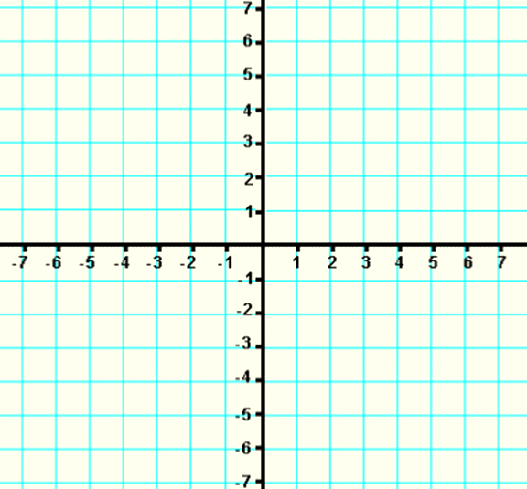
Graphing Linear Equations: Example
y=2x+1
Input X | Output Y | Work
-2
-1
0
1
2

Slide 7
Graphing Linear Equations: Example
y=-3x+2
Input X | Output Y | Work
-2
-1
0
1
2

Slide 8
Graphing Linear Equations: Example
-8x+4y=-12
Input X | Output Y | Work
-2
-1
0
1
2

Slide 9
Horizontal Lines
An equation is a horizontal line if it does not have an x variable. (only has a y variable)
Example:
y=2
y=-1
y=5
y=0

Slide 10
Horizontal Lines

Slide 11
Vertical Lines
An equation is a vertical line if it does not have a y variable (only has an x variable)
Example:
x=2
x=-1
x=5
x=0

Slide 12
Vertical Lines

Slide 13
Class Work
Blue book: pg 119 # 1-15
Blue Book: pg 121 # 1-6

Slide 14
Homework
Page 214-215 # 15-20, 36,37,40,41

